Slide 1
The Treaty of Versailles
Peace and Future Cannon Fodder

Slide 2
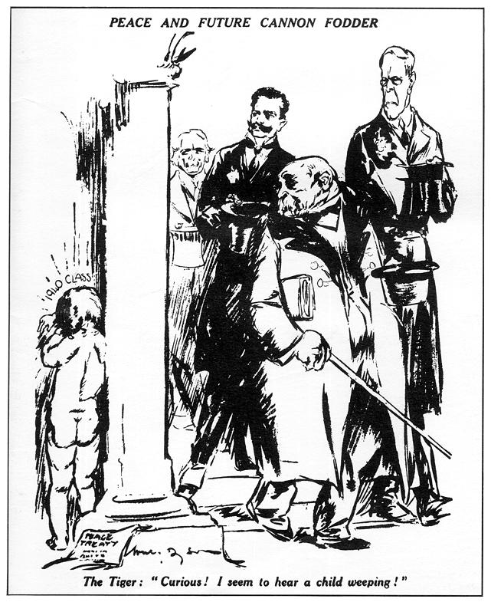
'Peace and future cannon fodder' - a cartoon of 1919 by the Australian artist Will Dyson which appeared in the Daily Herald of 1919.
What is the message of the source

Slide 4
'Peace and future cannon fodder' - a cartoon of 1919 by the Australian artist Will Dyson which appeared in the Daily Herald of 1919.
What can we learn from the title and caption?
Who are these men and what are they doing?
What is this child doing ? How old will he be in 1940 if he is a child in 1919? How does his crying link to the title?
Why is the child naked and what does it represent?
What is the comment at the foot of this cartoon saying?
What does the piece of paper signify on the floor?
Check Answers

Slide 5
'Peace and future cannon fodder' - a cartoon of 1919 by the Australian artist Will Dyson which appeared in the Daily Herald of 1919.
What can we learn from this caption?
This title was given to this cartoon, as it was believed that all the Treaty of Versailles did was set up the future generations of the world to be nothing more than “cannon fodder”
Who are these men and what are they doing?
Three four figures are leaving the building. They represent Lloyd George, Clemenceau (the Tiger), the prime minister of Italy Vittorio Orlando and Wilson. The Big Four have made the Treaty and believe that they have finished their work. Clemenceau is in front of Wilson and Lloyd George to show that The Tiger was the main decision maker and beneficiary of the Treaty.
What is this child doing ? How old will he be in 1940 if he is a child in 1919? How does his crying link to the title?
Clemenceau (’the Tiger’) hears a baby weeping; it is labelled 1940 class (= liable for call-up in 1940). The child is weeping because he is going to be ‘cannon-fodder’ in 1940. The Treaty will not bring a lasting peace – there will be another world war in 20 years’ time.
Why is the child naked and what does it represent?
The child is naked –Message is that what Germany possessed, had been stripped away from them.
What is this comment saying?
Clemenceau looking over his shoulder while commenting “Curious! I seem to hear a child weeping!” gets the audience to depict him as a pitiless and callous man. His comment suggests that he does not notice or understand Germany’s cries for more considerate terms
What does the piece of paper signify on the floor?
Beside the feet of the young boy is the peace treaty, which explains that Germany does not agree with these terms, as they are harsh and incredibly one-sided

Slide 6
Source Analysis
N – Nature (What type of source is it)
O – Origin (When and where was it made and by whom)
P – Purpose (Why was it made and was it public or private source)
C – Content (What can you see in the source)
C – Context (What is going on at the time)
C – Content (What does the content say about the context)

Slide 7
Content – What is going on in the cartoon?
Four men are leaving a building.
They are carrying their coats and hats, they have finished.
The pillar represents a grand building.
A child is crying behind a pillar.
A copy of the peace treaty is by it's feet.
The man in front finds it difficult to understand why the child is upset. He looks quite pleased with himself.

Slide 8
Context – What is going on at the time?
Peace Treaty being discussed at Versailles.
Big Four -Clemenceau, Lloyd George, Woodrow Wilson’ and Orlando.
Demand that Germany should be punished.
Wilson Fourteen Points could be basis for peace.
WW1 supposed to be the war to end all wars.
Who would pay for damage?
How could war be avoided in the future?
The leaders could not agree on what to do with Germany.

Slide 9
Comment – What point is the cartoonist trying to make?
The Big Four- Clemenceau, Wilson, Orlando and Lloyd George negotiated the peace settlement.
The building is the Palace of Versailles where the Germans had to sign the Treaty.
The child has read the treaty and as been upset by it's terms.
In 1940 the child will be 21 old enough to fight, he believes there will be a war then.
The Tiger does not understand why the child is crying even though he should understand the situation. He had lived through the France-Prussian War 1870-71, and like all the French had been angered by the harsh treaty which saw France lose Alsace-Lorraine to Germany. France had always sought revenge for that loss. He should realise that Germany will now want revenge for her losses in the Treaty of Versailles.
The order in which they leave suggests the level of blame for the treaty.
The title suggests there is peace now but there will be war in the future and that war will begin in 1940.

Slide 10
What is the message of the source? [6]
The message of this source is ….

